Slide 1
British Airways
Predictive model and its results from Skytrax
28/11/2022

Slide 2
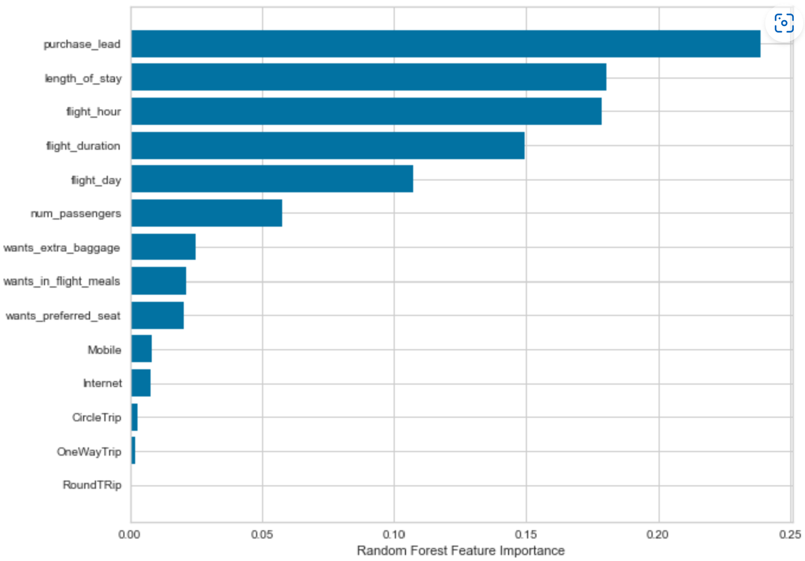
Predictive modelling results
Recall Rate
60%
Chance of predicting true successful bookings.
Will be predicted as actually completed bookings out of all successfully completed bookings.
Precision
61%
66% Chance of predicting true incomplete bookings correctly.
Accuracy
62%
Accuracy of the model predicting successful or incomplete booking is
Accuracy of the model predicting successful or incomplete booking i
From 1000 reviews here is the final output that passengers decision on flight bookings .
Top features that can drive successful flight bookings.

